Slide 1
Bankruptcy Prevention
P205

Slide 2
Team members:
Mr. Tittu A
Miss. Dayana Singh
Mr. Vijayakumar Reddy
Ms. Jayashri Bhivaji Gurule
Ms. Sakshi Modi
Sachin Dnyaneshwar Kanhurkar
Ms. Sejal Singh
Mentor: Madishetti Rajashekar
2

Slide 3
Business Objective:
The goal of this particular project is to check if a business goes bankrupt from different factors like industrial risk, management risk, financial flexibility, credibility, competitiveness and operating risk and prevent bankruptcy.
3

Slide 4
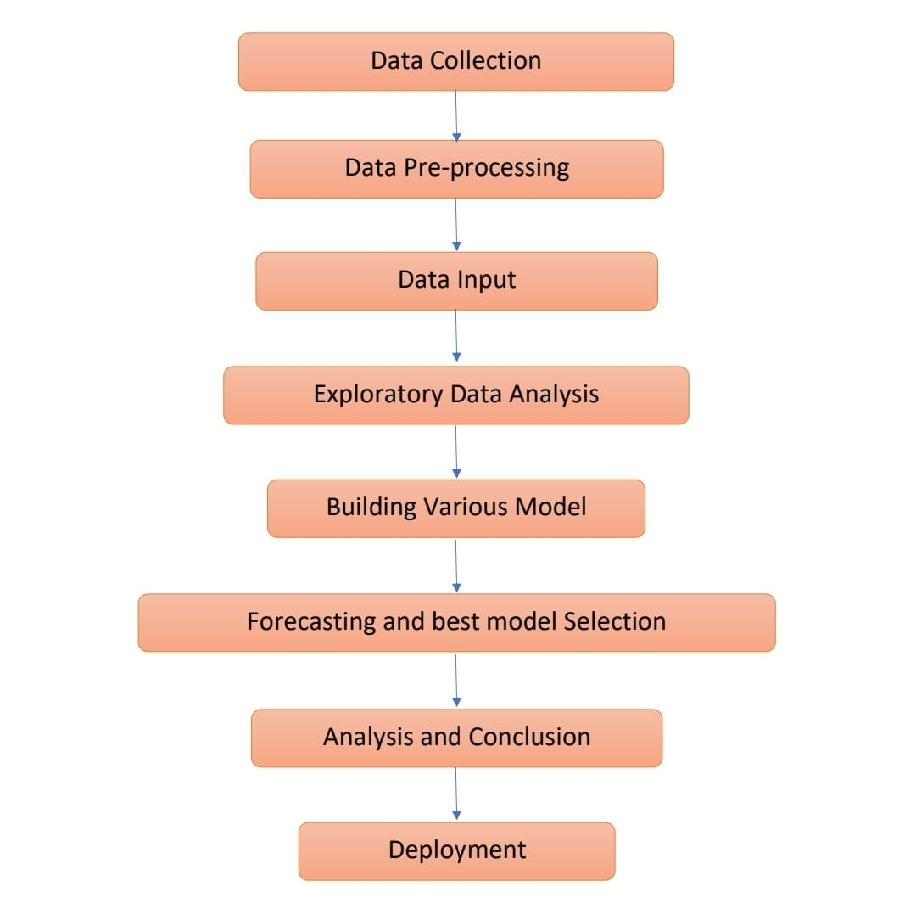
Project Workflow:
4

Slide 5
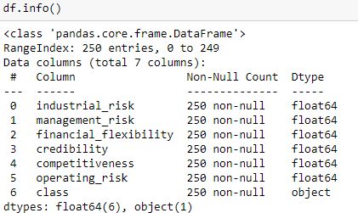
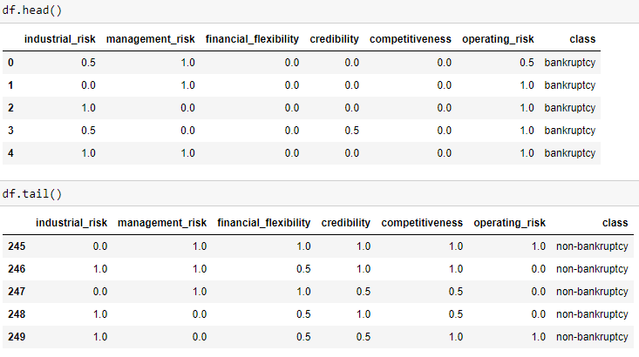
Data Set details:
The data set contains no null values.
There are 250 rows and 7 columns
The first 6 columns are float type and the class column is object type.
There are 3 categorical value in the first 6 columns : 0=low risk, 0.5=medium risk, 1=high risk.
And the class is either bankruptcy or non-bankruptcy.

Slide 6
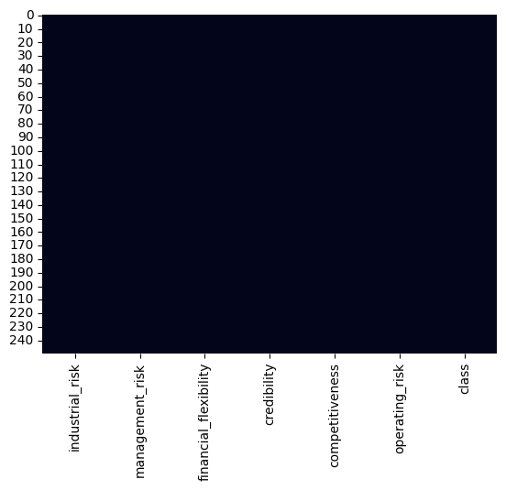
Missing Values Check:
industrial_risk 0
management_risk 0
financial_flexibility 0
credibility 0
competitiveness 0
operating_risk 0
class 0
dtype: int64
There is no missing values is data set.
Slide By Sachin
6

Slide 7
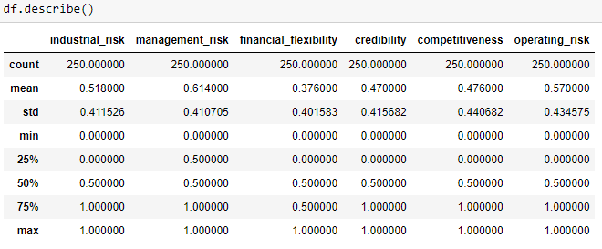
Data Description:
Here we found the count, mean, std, min, max of each column using df.describe() function
7

Slide 8
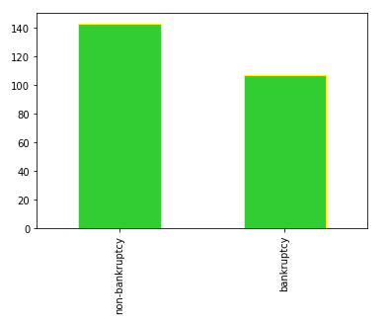

Check for class imbalance:
Graphical representation of the binary object column.
There are 143 non-bankruptcy and 107 bankruptcy case.

Slide 9
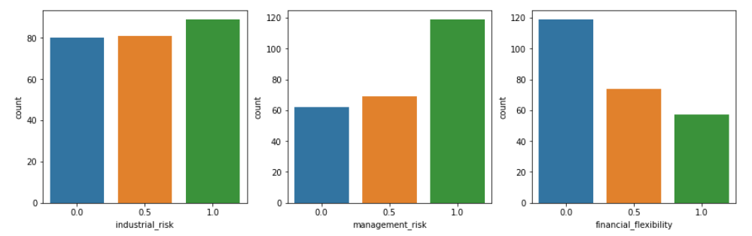
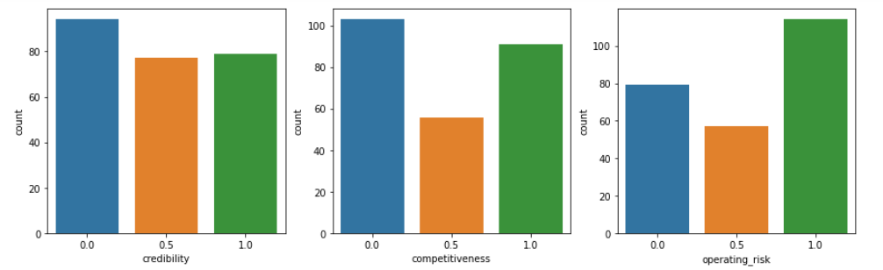
Values of different factors affecting bankruptcy:
9

Slide 10
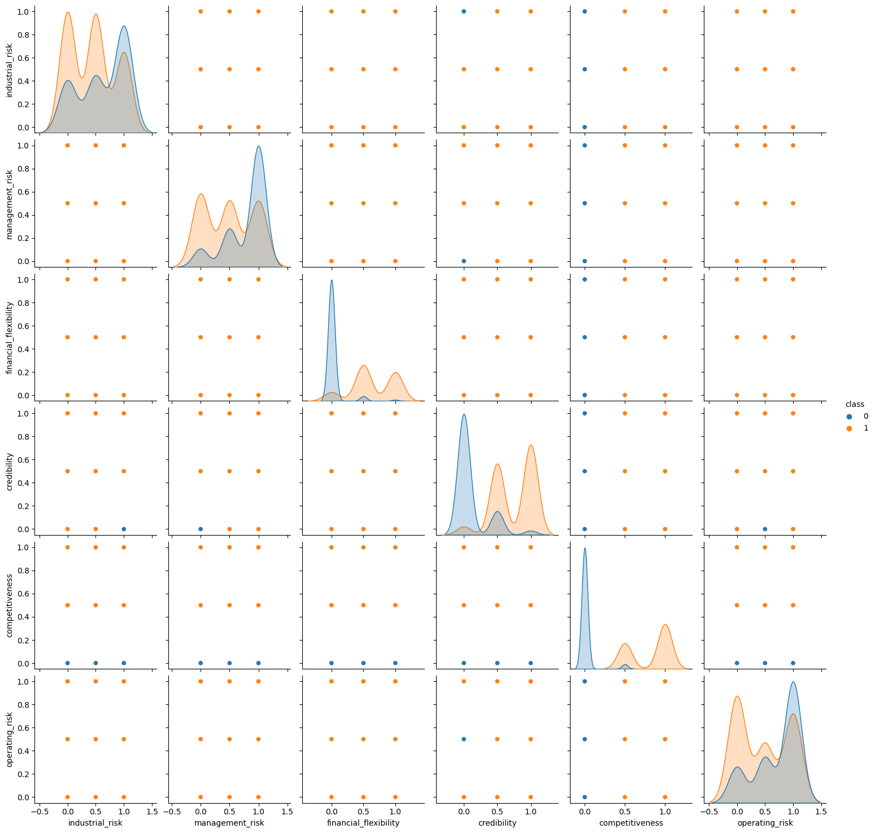
Explore relationships between features:
Pairplot
Slide By Sachin
10

Slide 11
Chi-Square Test
chi-square test is used to explore the relationship between two categorical variables
The null hypothesis can be framed in the below manner: The grouping variables have no association or correlation amongst them.
The alternate Hypothesis goes as framed below: The variables are associated with each other and happen to have a correlation between the variables.
Assume significance value (alpha = 0.05)
Reject the null hypothesis if p value < alpha
Relation between | p value | Decision | Comment
management_risk and class | 2.3366640799655196e-08 | Reject NULL HYPOTHESIS | Have association
industrial_risk and class | 0.0003510555520073703 | Reject NULL HYPOTHESIS | Have association
financial_flexibility and class | 7.334022479874038e-38 | Reject NULL HYPOTHESIS | Have association
credibility and class | 5.877823993544079e-35 | Reject NULL HYPOTHESIS | Have association
competitiveness and class | 1.017869598909574e-51 | Reject NULL HYPOTHESIS | Have association
operating_risk and class | 5.429569801610119e-05 | Reject NULL HYPOTHESIS | Have association
industrial_risk and credibility | 0.5283732539902525 | ACCEPT NULL HYPOTHESIS | No association
Slide By Sachin

Slide 12
ML Models on Dataset
Model Name | Accuracy Score in %
DecisionTreeClassifier | 100
SVM | 97.33
KNeighborsClassifier k=5 | 100
Multinomial Naive Bayes classifier | 98.66
GradientBoostingClassifier | 98.66
RandomForestClassifier | 100
Neural network | Best parameters: {'dropout1': 0.2, 'dropout2': 0.5, 'units1': 64, 'units2': 64} Best accuracy: 85.71
Slide By Sachin

Slide 13

Deployment
We finalised our model based on highest accuracy that was 100 percent from random forest classifier.
We used streamlit to deploy our model.

Slide 14
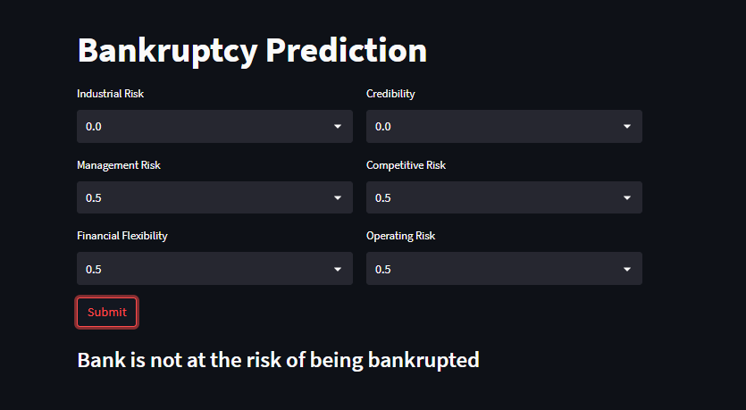

Output screen
Based on the input value selected, that the user has selected the model returns the status of the whether the bank goes bankrupt or not.

Slide 15
Challenges
The data research is most likely low sensitivity, for instance, either good/bad or yes/no. Quantitative analysis cannot be performed on categorical data which means that numerical or arithmetic operations cannot be performed.

Slide 16
Thank You

